Slide 1
“Oil, but Not Olive Oil”
Greece’s Oil Industry and its Unlikely Transition to an Export-Oriented Model [Parts I and II]
CHRISTOS TSAKAS
AGGELOS DROUGOUTIS
STEFANOS VAMIEDAKIS
[INSTITUTE FOR MEDITERRANEAN STUDIES-FORTH]
*SUPPORTED BY THE HELLENIC FOUNDATION FOR RESEARCH & INNOVATION [7003]

Slide 2
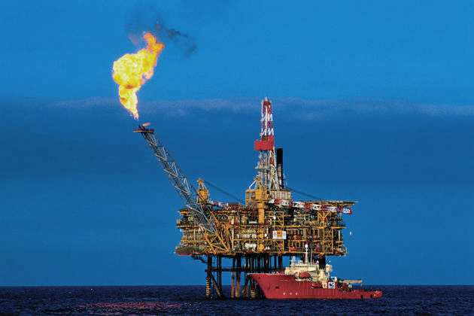
2019: Greece, with 21.2 m. tons of primary refining capacity, ranked 9th on the relevant list of the European Economic Area members.
2018: refined petroleum exports, with a value of USD 12 billion, represented over 30% of Greece’s total exports.
2018: Greek owners controlled over a quarter of the world’s oil tanker fleet.

Slide 3
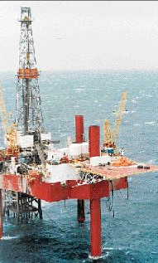
This paper demonstrates that shipping and oil have been intertwined since the establishment of Greece’s first refinery in 1957/58, and shows that it is far from coincidental that the Greek oil industry’s rise dates back to the late 1960s and early 1970s; a period of heavy shipowning investment in Greek manufacturing. Our main argument is that the petroleum industry epitomizes the Greek economy’s course from the restoration of its interwar outlook in line with Marshall goals to the rapid industrialization in view of the opportunities opened up by a special relationship with West Germany; opportunities further broadened by Greece’s subsequent participation in European integration from the 1960s on.

Slide 4
Present–day
Hellenic Petroleum:
Present-day
Motor Oil Hellas:
Aspropyrgos Refinery
(1957-58)
Thessaloniki Refinery
(1966)
Elefsina Refinery (1971)
Corinth Refinery (1972)

Slide 5
1949–1957
From US aid to German Credits
Marshall Plan
-Restoration of (West) Germany as the main capital-goods producer/exporter in Europe
-Rejection of Greek industrialization ambitions
Korean War (1950-53):
Boosted demand for capital goods
US focus shifted away from Europe
Military priorities
Greek Civil War 1946-49
Burden sharing
Expectations and Frustrations
Loans to cement industry, chemicals, mining (lignite, bauxite), basic metallurgy.
NO approval of oil refineries, aluminium plant, shipyards, major hydropower projects.

Slide 6
1949–1957
From US aid to German Credits
German-Greek Accords (1953 and 1955)
DM 200 m. (USD 50 m.)
Eligible industrial projects
-Lignite and thermoelectric plant (Bodossakis/Krupp)
-Nitrogen fertilizers (Bodossakis)
-Nickel mines (Bodossakis/Krupp)
-Oil refinery (Hydro/Bodossakis/Niarchos/Mobil)
-Shipyards (Niarchos)
-Modernization of the Greek Communications infrastructure (Siemens/Telefunken/Voulpiotis)
Export credits to Greece purchase equipment from German firms
Joint ventures/concessions
Return of German assets

Slide 8
NOT THE WHOLE STORY
(DATA easily accessible through BoG, though)
It was specifically designed to include US FDI
A good part of US share (40%) represents ship-owning capital (Stavros Niarchos)
The French share comes down to one single investment (Aluminium of Greece)…
…in which the Germans denied to participate, although they were offered 25% of the shares by the French, because they had reservations about its viability (which proved right in the long-run)
Most importantly, the German credits did not form an FDI and are not included in this RD
USA

Slide 9
Notes:
Greece’s growth rates over the years 1950-1973: 6.2% annually (compared to 5.5 for Portugal and Spain)
Industry surpasses agriculture already in the early 1960s

Slide 10
Liquid fuels and lubricants imports
1968:
$105m.
1962:
$49.8m.

Slide 11
1968
the Greek-owned tanker fleet represented 15% of the world total, with Onassis and Niarchos owning the sixth (2,078 thousand DWT) and the eighth (1,799 thousand DWT) biggest tanker fleets respectively

Slide 12
Huge Deals
Onassis’s Refinery Project(1970): $700m. Private investments for an industrial complex
Privatization of Aspropyrgos’s Refinery (1970) for industrial investments up to $200m. in return

Slide 13
energy consumption (in million metric tonnes of coal equivalent): Energy consumption (million metric tons coal-equivalent)
Annual growth of Greek
industrial production 1961-73: +13,5%
1973:
12,6
manufacturing share in the energy consumption rose from 27.6% in 1960
to 40% in 1973
liquid fuels making up 75% of primary energy inputs
1960:
3

Slide 14
Europeanization under authoritarian rule: economic trends
GDP growth
Year | Growth | Annual average growth
1968 | 7,2% | 9%
1969 | 11,6%
1970 | 8,9%
1971 | 7,8%
1972 | 10,2%
1973 | 8,1%
1974 | -6,4% | -
Industrial / total exports
1967: 16% 1973: 46%
Source: Bank of Greece
Per capita income (% EU-15)
1967: 57%
1973: 70%
Source: Pagoulatos 2003
Source: Ministry of National Economy 1998

